Slide 1
Structural Testing

Slide 2
Software Testing
Structural Testing
A complementary approach to functional testing is called structural / white box testing. It permits us to examine the internal structure of the program.
Path Testing
Path testing is the name given to a group of test techniques based on judiciously selecting a set of test paths through the program. If the set of paths is properly chosen, then it means that we have achieved some measure of test thoroughness.
This type of testing involves:
generating a set of paths that will cover every branch in the program.
finding a set of test cases that will execute every path in the set of program paths.

Slide 3
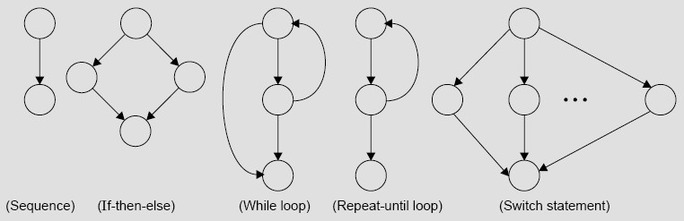
Software Testing
Flow Graph
The control flow of a program can be analysed using a graphical representation known as flow graph. The flow graph is a directed graph in which nodes are either entire statements or fragments of a statement, and edges represents flow of control.
Fig. 14: The basic construct of the flow graph

Slide 4
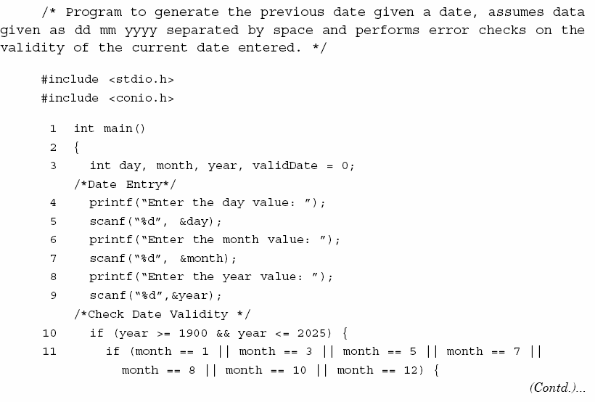

Slide 5
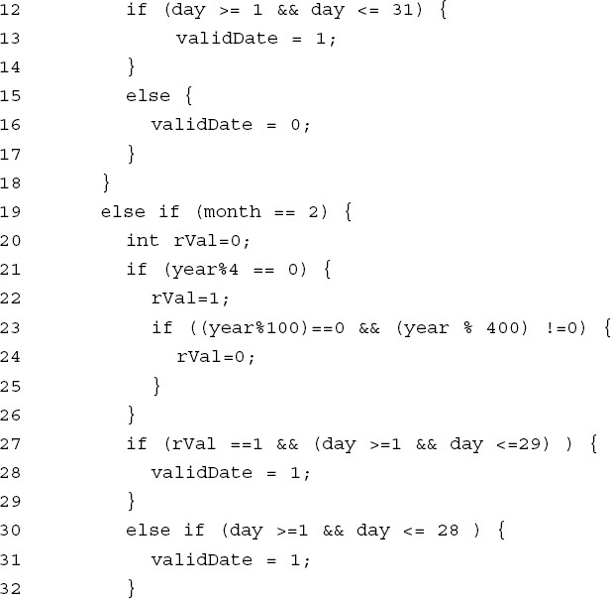

Slide 6
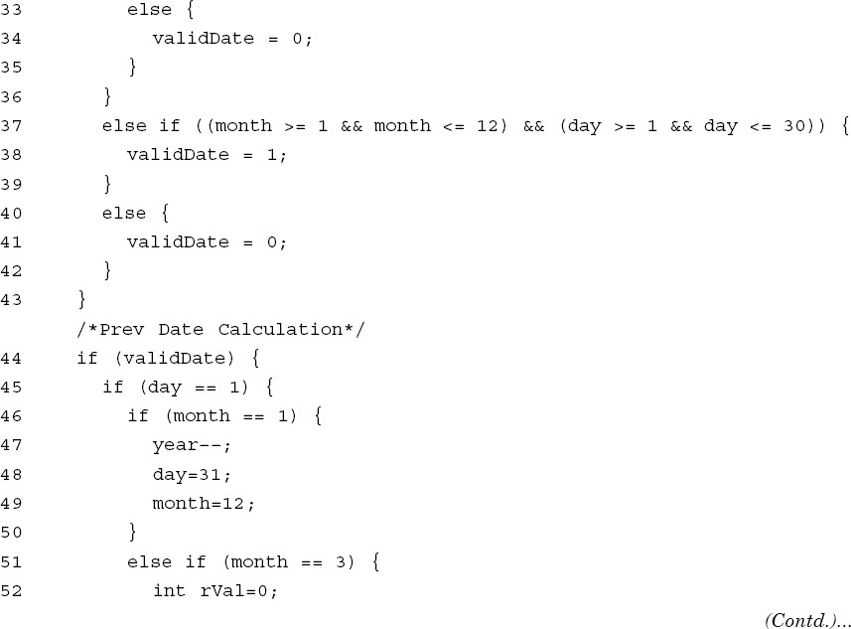

Slide 7
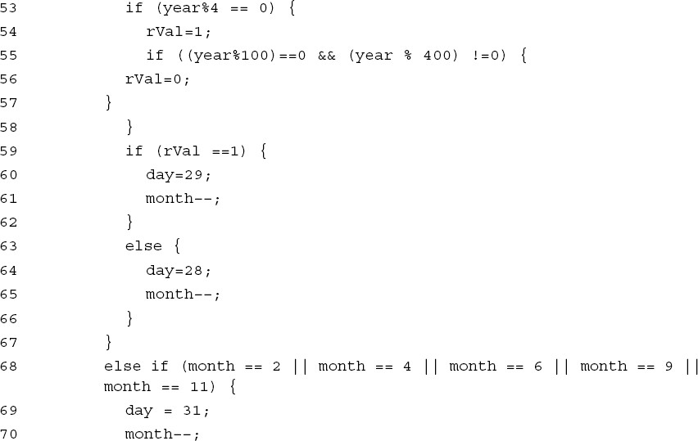

Slide 8
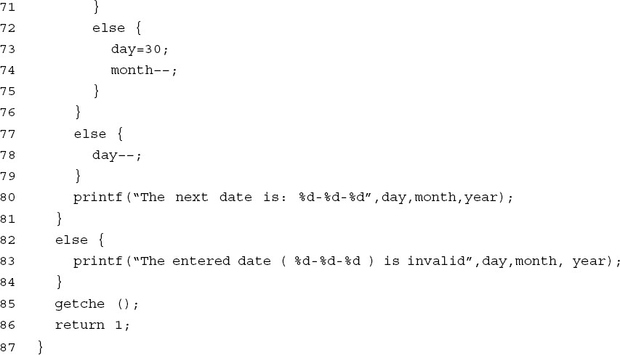

Slide 9
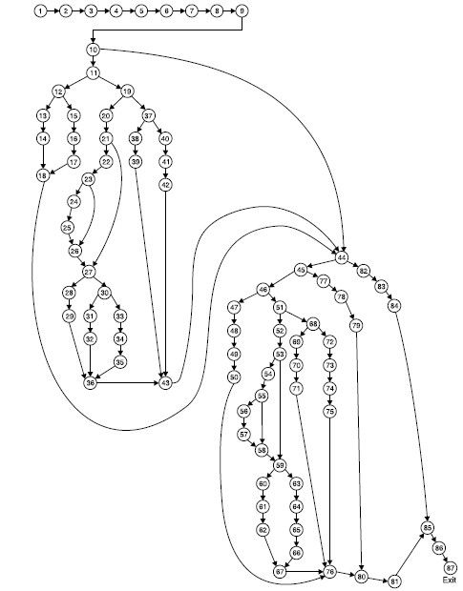
Fig. 16: Flow graph of previous date problem

Slide 10
DD (Decision to decision) Path Graph
Flow graph nodes | DD Path graph corresponding node | Remarks
1 to 9 | n1 | There is a sequential flow from node 1 to 9
10 | n2 | Decision node, if true go to 13 else go to 44
11 | n3 | Decision node, if true go to 12 else go to 19
12 | n4 | Decision node, if true go to 13 else go to 15
13,14 | n5 | Sequential nodes and are combined to form new node n₅
15,16,17 | n6 | Sequential nodes
18 | n7 | Edges from node 14 to 17 are terminated here
19 | n8 | Decision node, if true go to 20 else go to 37
20 | n9 | Intermediate node with one input edge and one output edge
21 | n10 | Decision node, if true go to 22 else go to 27
22 | n11 | Intermediate node
23 | n12 | Decision node, if true go to 24 else go to 26

Slide 11
Flow graph nodes | DD Path graph corresponding node | Remarks
24,25 | n13 | Sequential nodes
26 | n14 | Two edges from node 25 & 23 are terminated here
27 | n15 | Two edges from node 26 & 21 are terminated here. Also a decision node
28,29 | n16 | Sequential nodes
30 | n17 | Decision node, if true go to 31 else go to 33
31,32 | n18 | Sequential nodes
33,34,35 | n19 | Sequential nodes
36 | n20 | Three edge from node 29,32 and 35 are terminated here
37 | n21 | Decision node, if true go to 38 else go to 40
38,39 | n22 | Sequential nodes
40,41,42 | n23 | Sequential nodes
43 | n24 | Three edge from node 36,39 and 42 are terminated here

Slide 12
Flow graph nodes | DD Path graph corresponding node | Remarks
44 | n25 | Decision node, if true go to 45 else go to 82. Three edges from 18,43 & 10 are also terminated here.
45 | n26 | Decision node, if true go to 46 else go to 77
46 | n27 | Decision node, if true go to 47 else go to 51
47,48,49,50 | n28 | Sequential nodes
51 | n29 | Decision node, if true go to 52 else go to 68
52 | n30 | Intermediate node with one input edge & one output ege
53 | n31 | Decision node, if true go to 54 else go to 59
54 | n32 | Intermediate node
55 | n33 | Decision node, if true go to 56 else go to 58
56,57 | n34 | Sequential nodes
58 | n35 | Two edge from node 57 and 55 are terminated here
59 | n36 | Decision node, if true go to 60 else go to 63. Two edge from nodes 58 and 53 are terminated.

Slide 13
Flow graph nodes | DD Path graph corresponding node | Remarks
60,61,62 | n37 | Sequential nodes
63,64,65,66 | n38 | Sequential nodes
67 | n39 | Two edge from node 62 and 66 are terminated here
68 | n40 | Decision node, if true go to 69 else go to 72
69,70,71 | n41 | Sequential nodes
72,73,74,75 | n42 | Sequential nodes
76 | n43 | Four edges from nodes 50, 67, 71 and 75 are terminated here.
77,78,79 | n44 | Sequential nodes
80 | n45 | Two edges from nodes 76 & 79 are terminated here
81 | n46 | Intermediate node
82,83,84 | n47 | Sequential nodes
85 | n48 | Two edges from nodes 81 and 84 are terminated here
86,87 | n49 | Sequential nodes with exit node

Slide 14
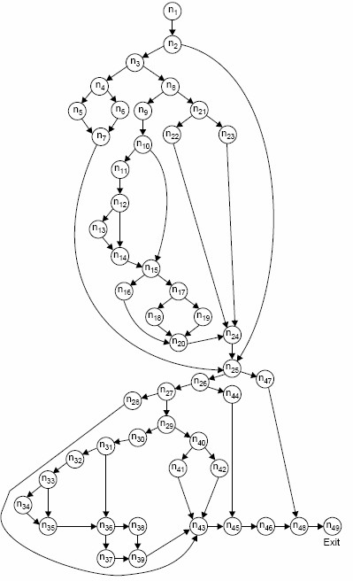
Fig. 17: DD path graph of previous date problem

Slide 15
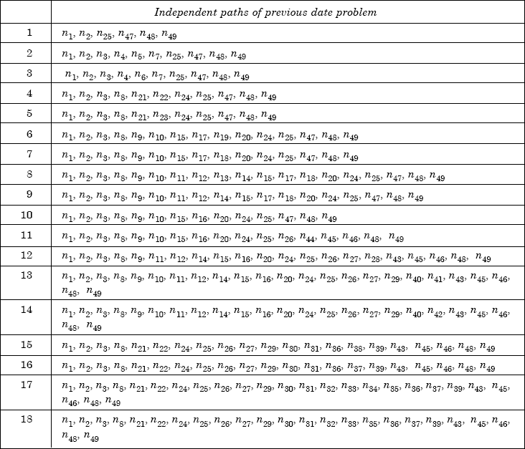
Fig. 18: Independent paths of previous date problem

Slide 16
Software Testing
Example
Consider the program given in for the classification of a triangle. Its input is a triple of positive integers (say a,b,c) from the interval [1,100]. The output may be [Scalene, Isosceles, Equilateral, Not a triangle].
Draw the flow graph & DD Path graph. Also find the independent paths from the DD Path graph.

Slide 17
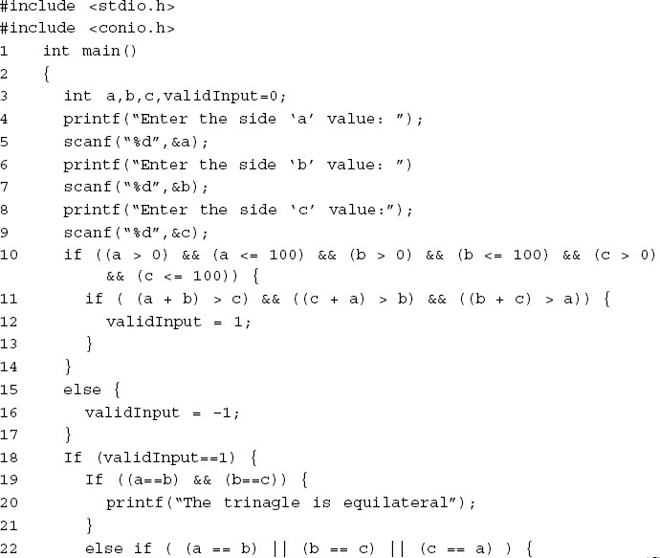

Slide 18
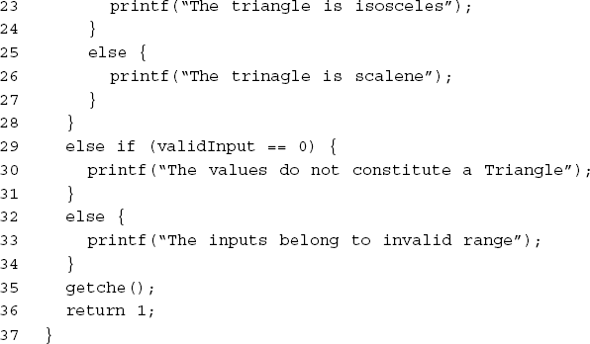

Slide 19
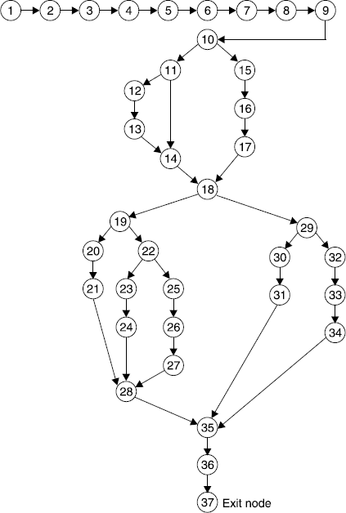
Solution :
Flow graph of triangle problem is:
Fig.8. 20 (a): Program flow graph

Slide 20
The mapping table for DD path graph is:
Flow graph nodes | DD Path graph corresponding node | Remarks
1 TO 9 | A | Sequential nodes
10 | B | Decision node
11 | C | Decision node
12, 13 | D | Sequential nodes
14 | E | Two edges are joined here
15, 16, 17 | F | Sequential nodes
18 | G | Decision nodes plus joining of two edges
19 | H | Decision node
20, 21 | I | Sequential nodes
22 | J | Decision node
23, 24 | K | Sequential nodes
25, 26, 27 | L | Sequential nodes

Slide 21
Flow graph nodes | DD Path graph corresponding node | Remarks
28 | M | Three edges are combined here
29 | N | Decision node
30, 31 | O | Sequential nodes
32, 33, 34 | P | Sequential nodes
35 | Q | Three edges are combined here
36, 37 | R | Sequential nodes with exit node
Fig. 20 (b): DD Path graph

Slide 22
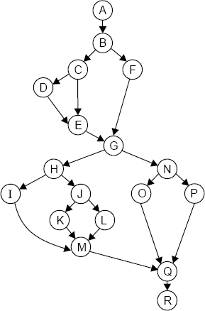
DD Path graph is given in Fig. 20 (b)
Independent paths are:
ABFGNPQR
ABFGNOQR
ABCEGNPQR
ABCDEGNOQR
ABFGHIMQR
ABFGHJKMQR (vii)ABFGHLJMQR
Fig. 20 (b): DD Path graph

Slide 23
Cyclomatic Complexity

Slide 24
Software Testing
Cyclomatic Complexity
Also known as structural complexity
Complexity measure is defined in terms of independent paths
Provides an upper bound on the number of test cases that must be conducted to ensure that all the statements have been tested at least once and every condition has been tested on its true side and false side.

Slide 25
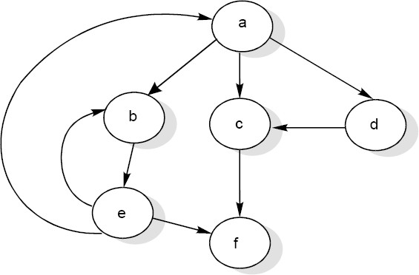
Software Testing
Cyclomatic Complexity
McCabe’s cyclomatic metric V(G) = e – n + 2P.
Where e = number of edges; n = number of nodes; p = number of connected components
For example, a flow graph shown under with entry node ‘a’ and exit node ‘f’.

Slide 26
Software Testing
The value of cyclomatic complexity can be calculated as : V(G) = 9 – 6 + 2 = 5
Here e = 9, n = 6 and P =1
There will be five independent paths for the flow graph illustrated in Fig. 21.
Path 1 :
Path 2 :
Path 3 :
Path 4 :
Path 5 :
a c f
a b e f a d c f
a b e a c f or a b e a b e f a b e b e f

Slide 27
Software Testing
Several properties of cyclomatic complexity are stated below:
1. V(G) ≥1
V (G) is the maximum number of independent paths in graph G.
Inserting & deleting functional statements to G does not affect V(G).
G has only one path if and only if V(G)=1.
V(G) depends only on the decision structure of G.

Slide 28
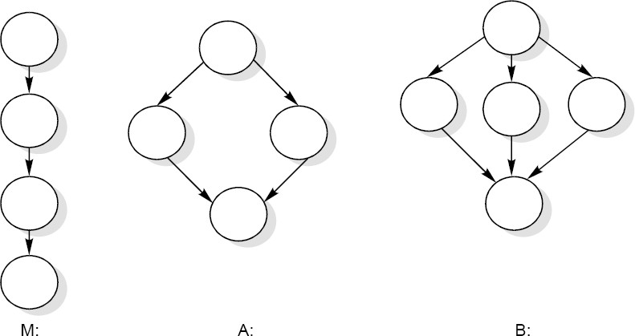
Software Testing
The role of P in the complexity calculation V(G)=e-n+2P is required to be understood correctly. We define a flow graph with unique entry and exit nodes, all nodes reachable from the entry, and exit reachable from all nodes. This definition would result in all flow graphs having only one connected component. One could, however, imagine a main program M and two called subroutines A and B having a flow graph shown below.

Slide 29
Software Testing
Let us denote the total graph above with 3 connected components as
V (M ∪ A ∪ B) = e − n + 2P
= 13-13+2*3
= 6
This method with P ≠
1 can be used to calculate the complexity of a
collection of programs, particularly a hierarchical nest of subroutines.

Slide 30
Software Testing
Notice that V (M ∪ A ∪ B) = V (M ) + V ( A) + V (B) = 6. In general, the complexity of a collection C of flow graphs with K connected components is equal to the summation of their complexities. To see this let C_{i},1 ≤ I ≤ K denote the k distinct connected component, and let e_{i} and n_{i} be the number of edges and nodes in the ith-connected component. Then
k k
V (C) = e − n + 2 p = ∑e_{i} − ∑ n_{i} + 2K
i=1 i=1
k
k
= ∑(e_{i} − n_{i} + 2) = ∑V (C_{i} )
i=1 i=1

Slide 31
Software Testing
Two alternate methods are available for the complexity calculations.
Cyclomatic complexity V(G) of a flow graph G is equal to the number of predicate (decision) nodes plus one.
V(G)= ∏ +1
Where ∏ is the number of predicate nodes contained in the flow graph G.
Restriction is that every predicate node must have only two conditions. If not, it needs to be converted so
Cyclomatic complexity is equal to the number of regions of the flow graph.

Slide 32
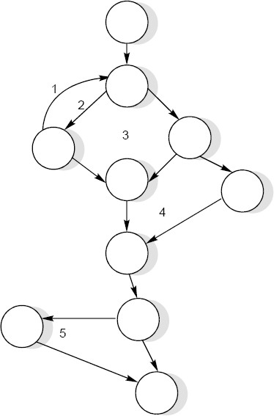
Software Testing
Example
Consider a flow graph given complexity by all three methods.
in Fig. 23 and calculate the cyclomatic

Slide 33
Software Testing
Solution
Cyclomatic complexity can be calculated by any of the three methods.
1. V(G)
= e – n + 2P
= 13 – 10 + 2 = 5
2. V(G)
= π + 1
= 4 + 1 = 5
3. V(G)
= number of regions
= 5
Therefore, complexity value of a flow graph in Fig. 23 is 5.

Slide 34
Software Testing
Example
Consider the previous date program with DD path graph. Find cyclomatic complexity.

Slide 35
Software Testing
Solution
Number of edges (e) = 65 Number of nodes (n) =49
(i)
(ii)
(iii)
V(G) = e – n + 2P = 65 – 49 + 2 = 18 V(G) = π + 1 = 17 + 1 = 18
V(G) = Number of regions = 18
The cyclomatic complexity is 18.

Slide 36
Software Testing
Example 8.18
Consider the classification of triangle problem. Find the cyclomatic complexity.

Slide 37
Software Testing
Solution
Number of edges (e) = 23 Number of nodes (n) =18
(i) V(G) = e – n + 2P = 23 – 18 + 2 = 7 (ii) V(G) = π + 1 = 6 + 1 = 7
(iii) V(G) = Number of regions = 7
The cyclomatic complexity is 7. Hence, there are seven independent paths.

